Slide 1
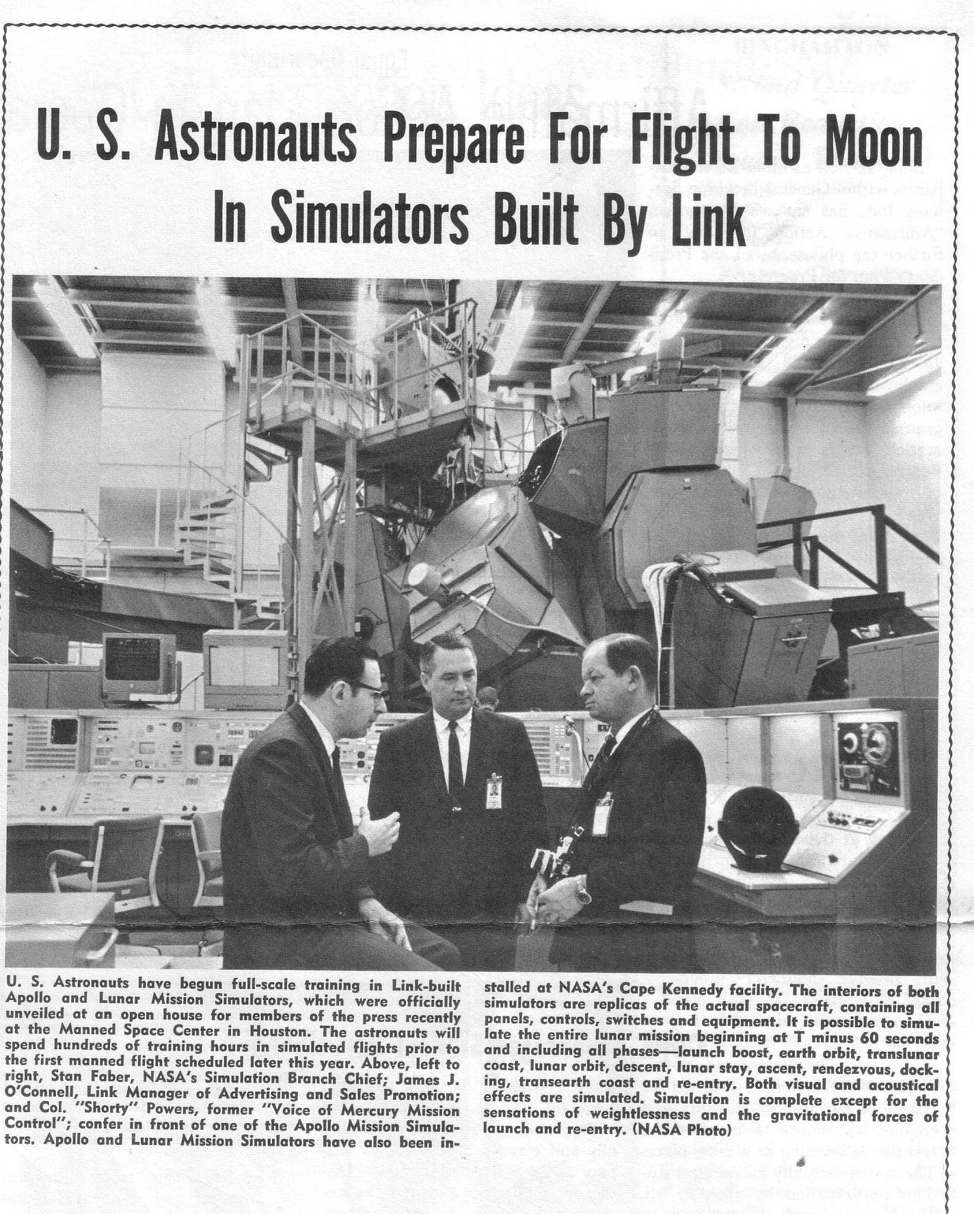

Slide 2
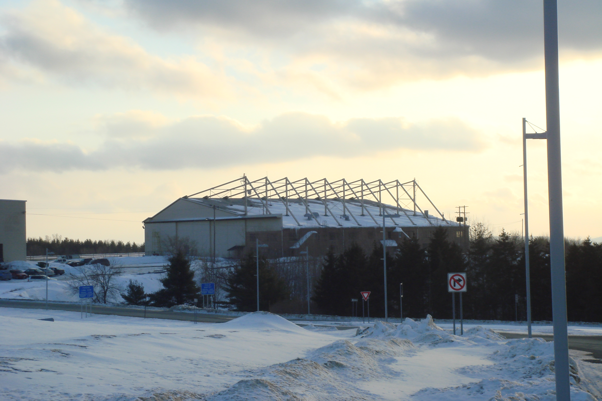
Hangar # 2, BGM airport, built 1956
GP-Link Apollo-era simulators designed & built here

Slide 4
On long-term loan from National Air & Space Museum, GP- Link’s
Lunar Module Simulator Visual System
is slated to be a signature
visitor experience at TechWorks!
Operational telescope display
Operational overhead starball
Side window optical system
reassembled to demonstrate
pre-digital graphic technology
Pending NASA donation - Apollo 15 Lunar Surface Map display
Thanks to our sponsors & partners

Slide 5
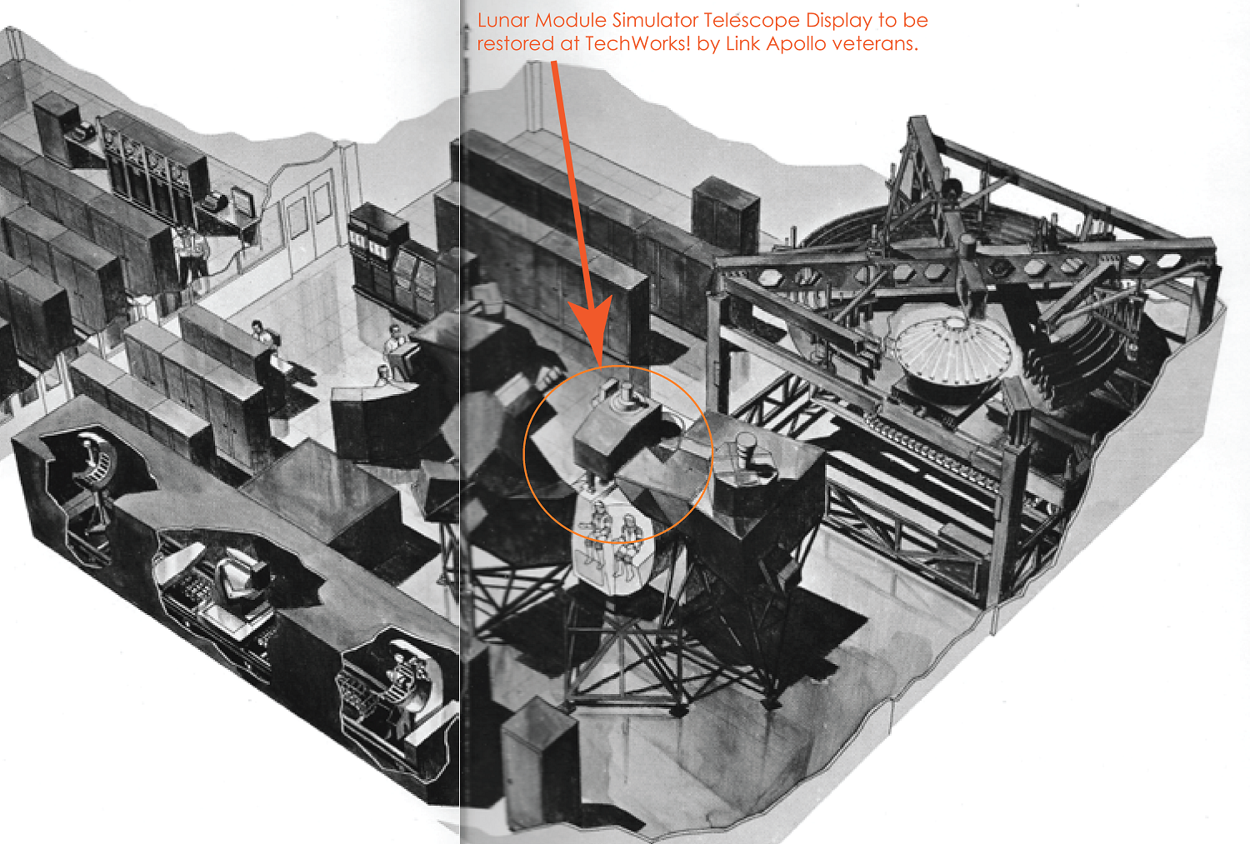

Slide 6
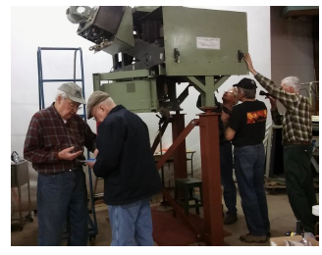

Slide 7
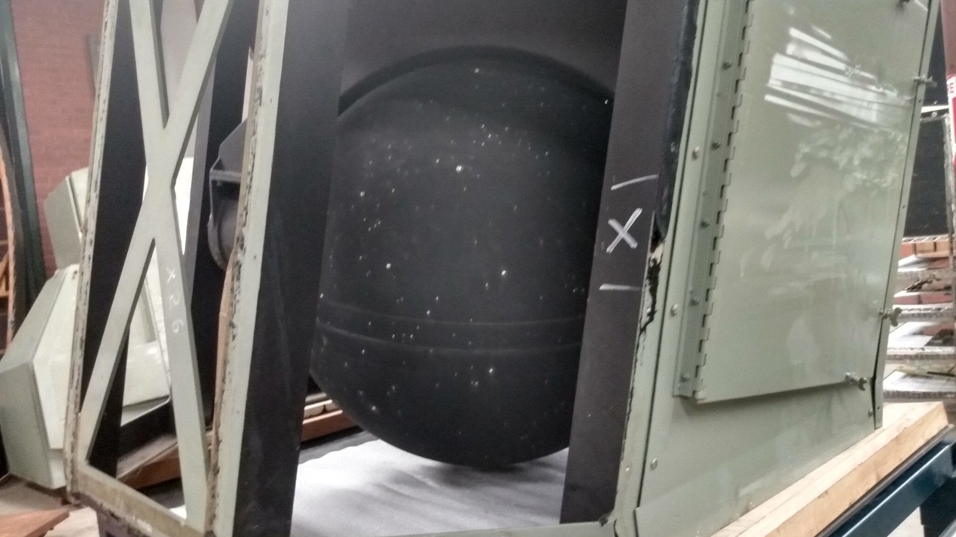
LMS Overhead Window starball – on long-term loan from National Air and Space Museum

Slide 9
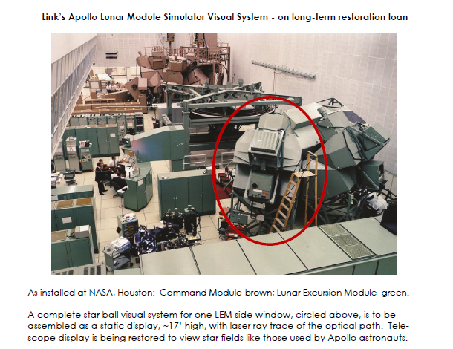

Slide 10
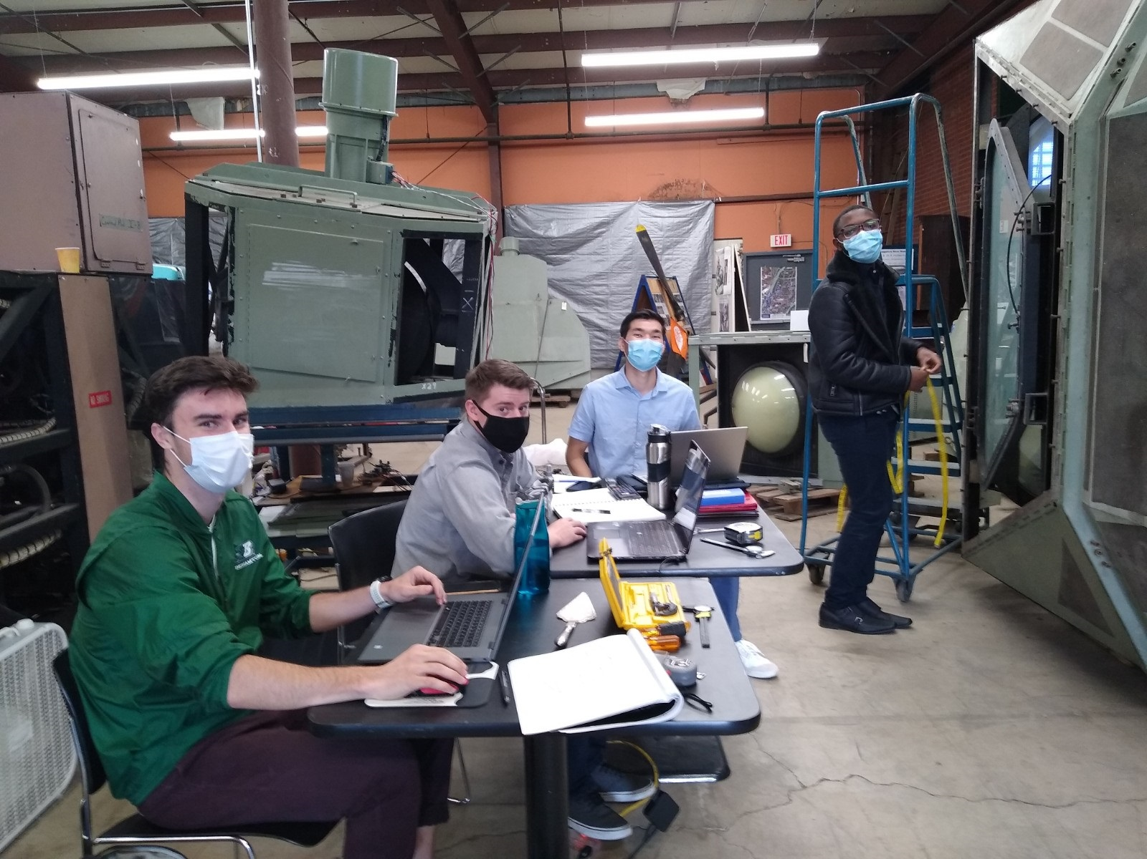
2020-2021
Watson School
Capstone
Team
Mission:
1. Figure out
how the pieces fit
together.
2. Design a stable
assembly plan for
LMS side window
visual display
Jack Murphy, Jeff
Hotaling, Asan
Anarkulov, Jalaal
Shah-Taylor
Advisors:
Prof. Mir Razavi
Art Law

Slide 11
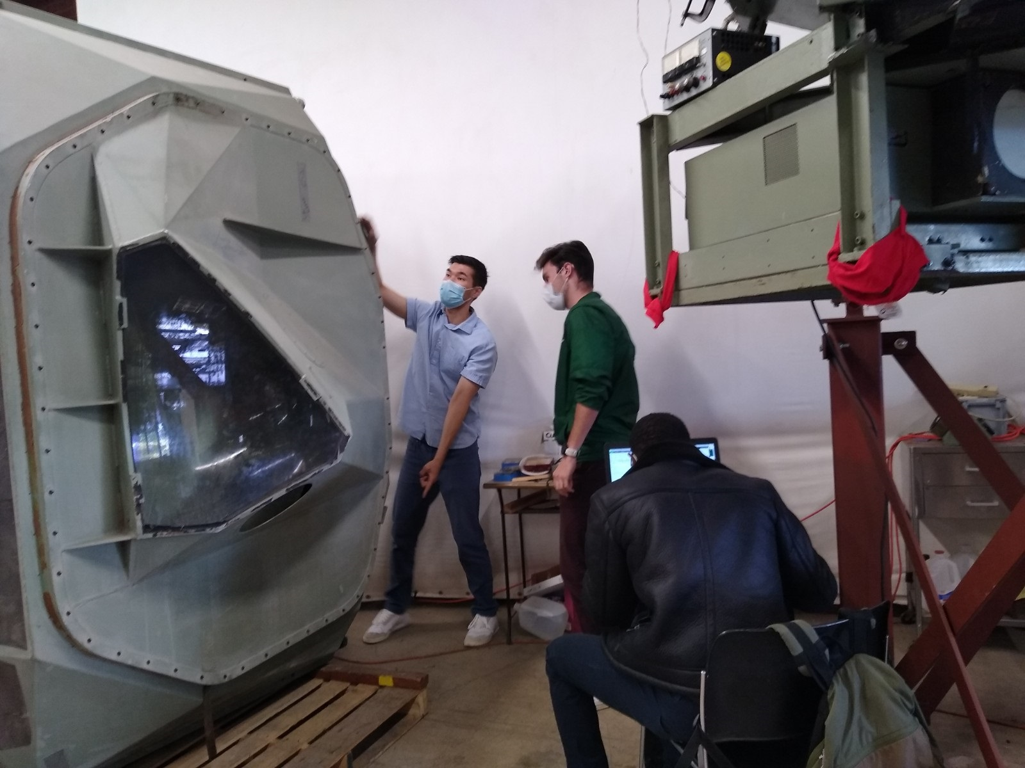

Slide 12
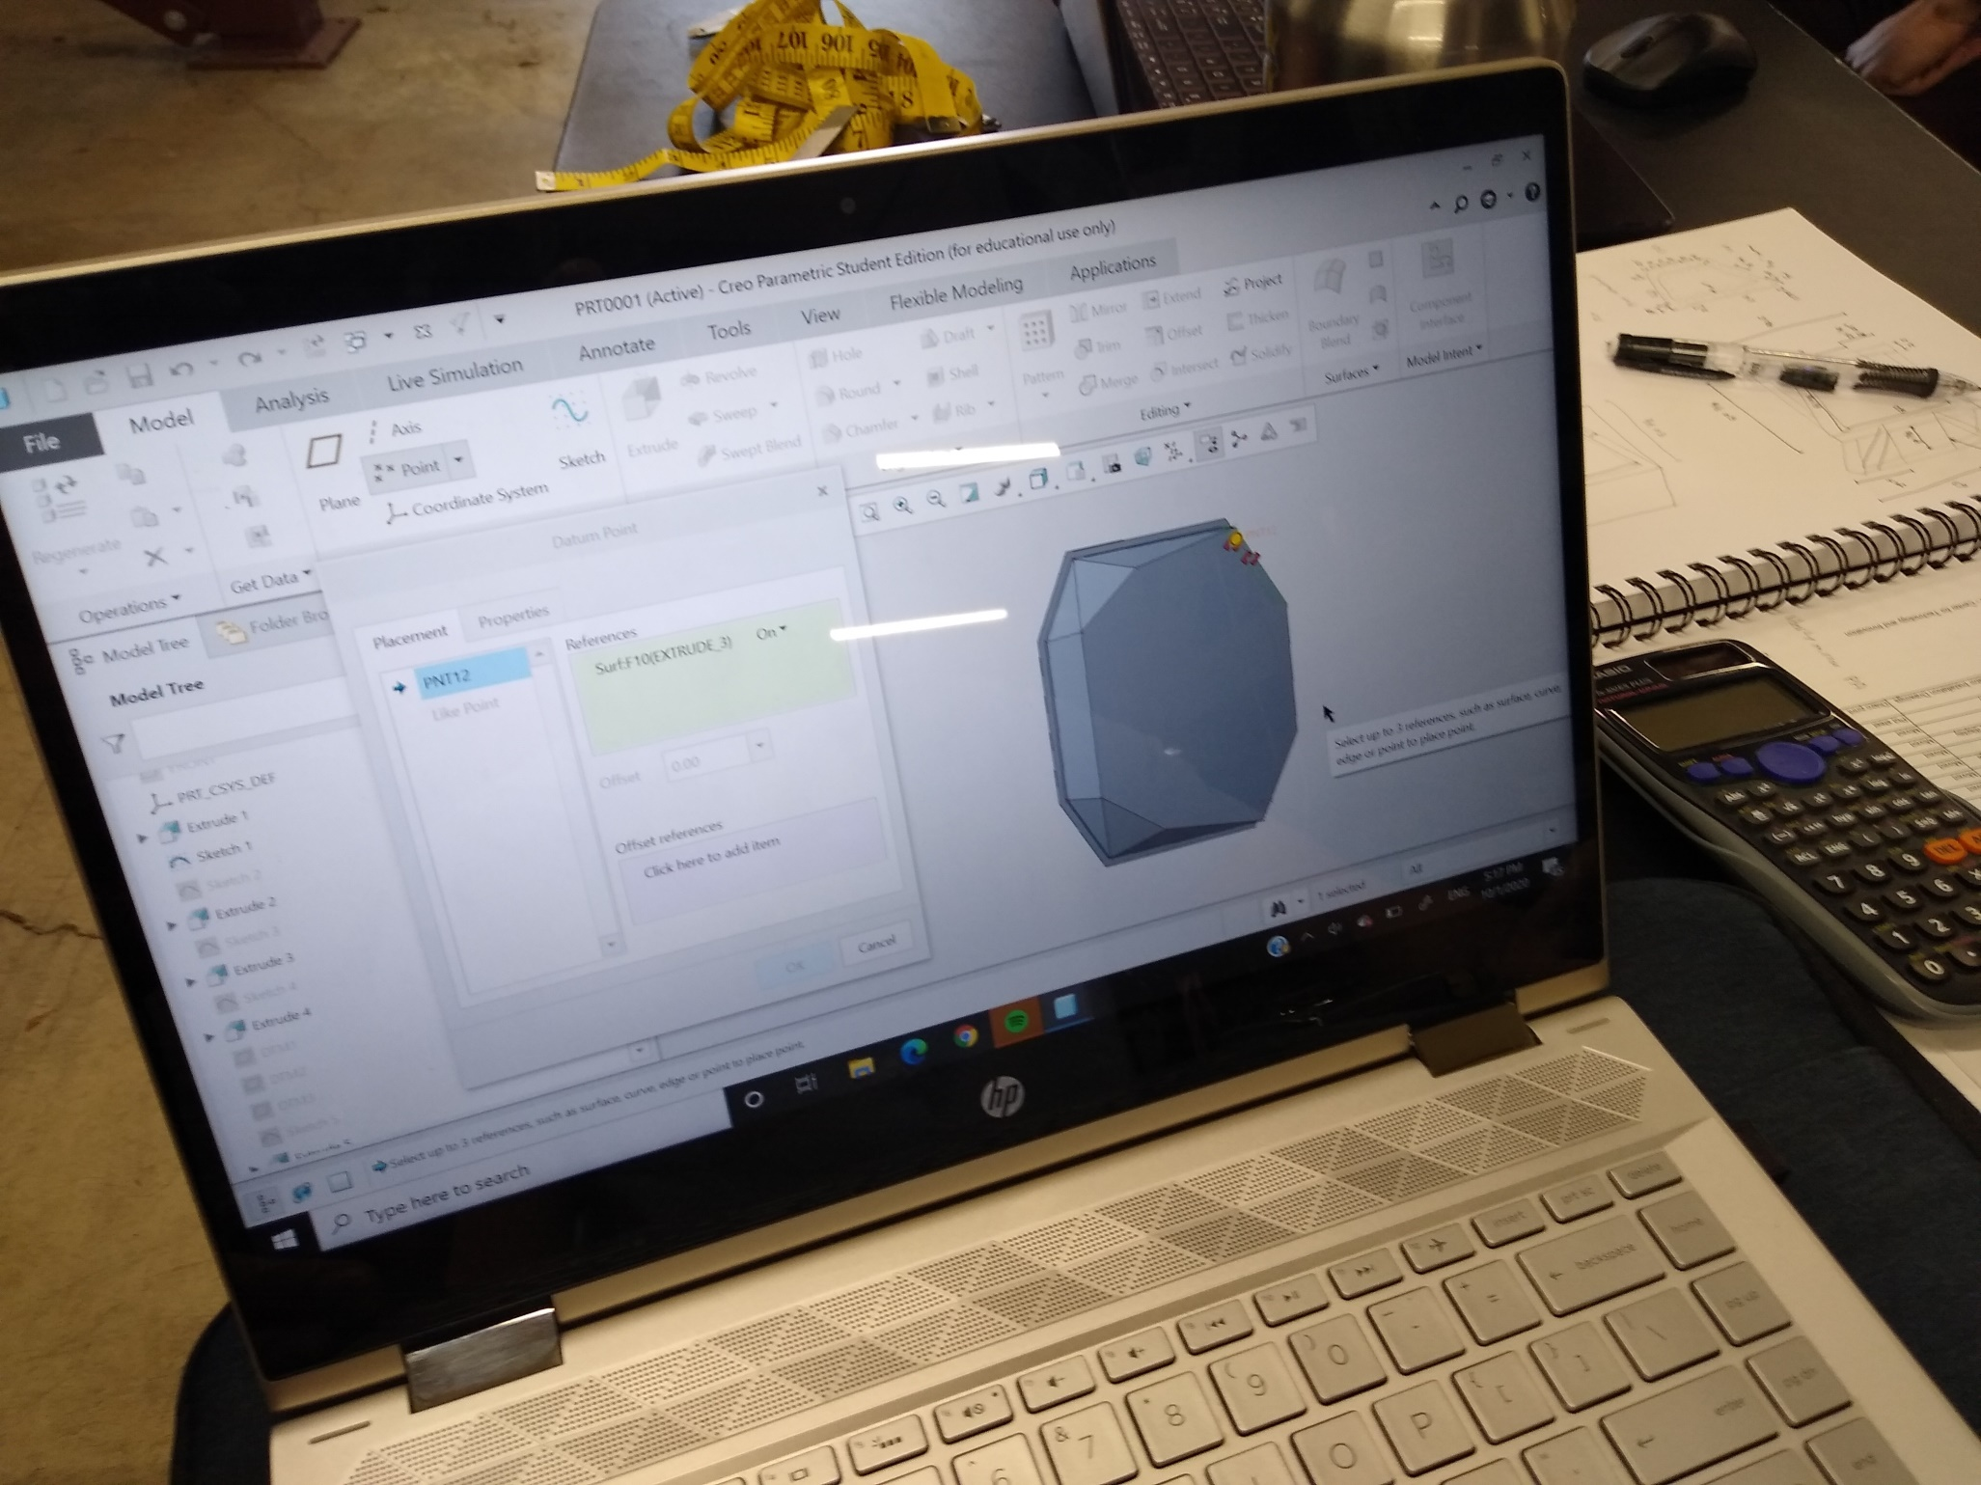

Slide 13
Lunar surface map for training Apollo 15 astronauts – ready to depart GP-Link, Binghamton, 1960s
Photo courtesy of NASA Archives

Slide 14
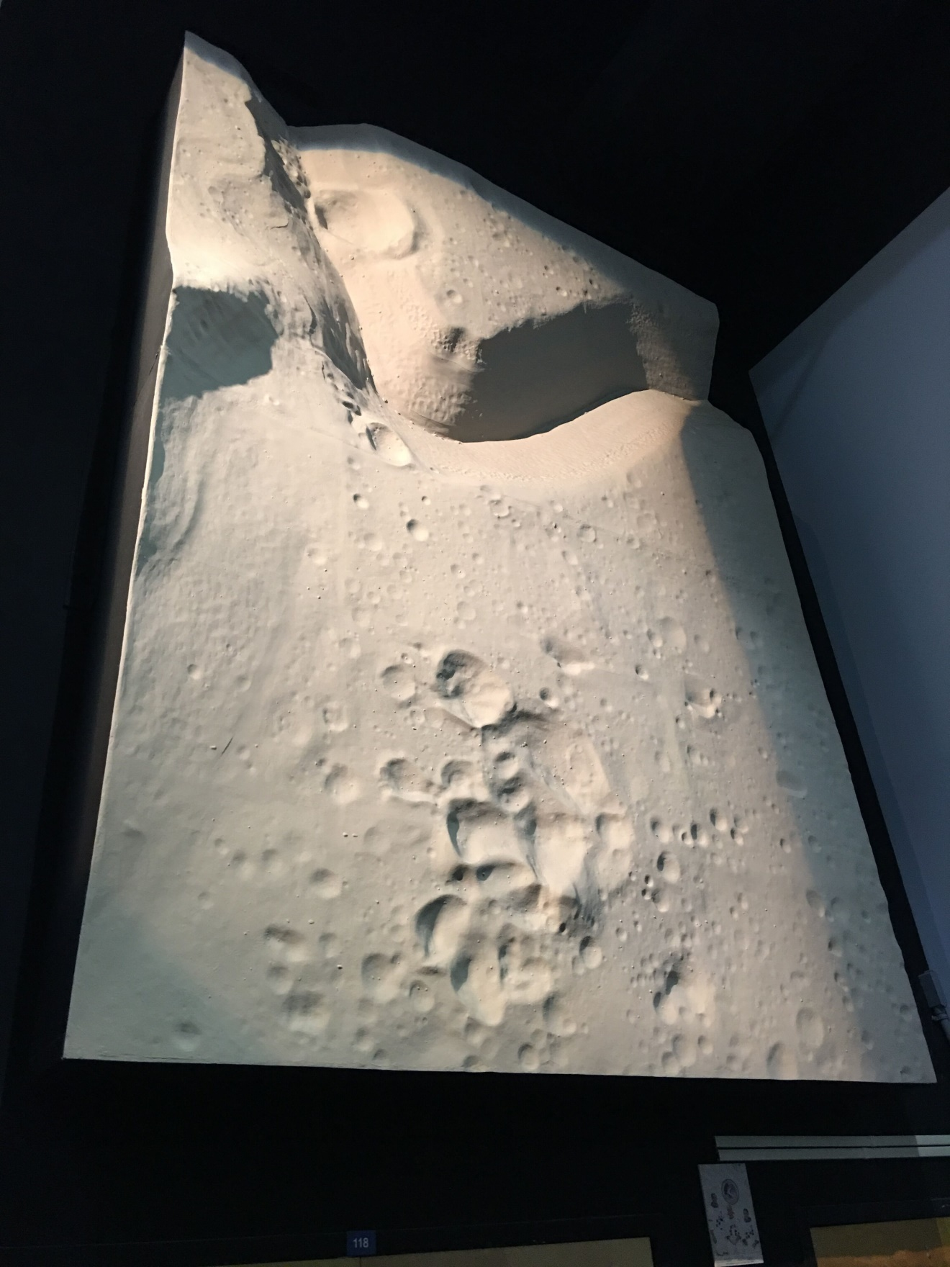
Apollo 15 Lunar surface map built in
Binghamton for NASA simulator, 1960s.
As of Oct 2020, installed in hurricane-
damaged structure in Florida.
To be transferred from NASA to the
Center for Technology & Innovation
as soon as private funding sources secured
& TechWorks! Central Block roof repaired.

